Slide 1




University Institute of Engineering
Department of Computer Science & Engineering
COMPUTER ORGANIZATION & ARCHITECTURE
(23CST-204/23ITT-204)
ER. SHIKHA ATWAL
E11186
ASSISTANT PROFESSOR
BE-CSE

Slide 2
INTRODUCTION
Computer organization is concerned with the way the hardware components operate and the way they are connected together to form the computer system. The various components are assumed to be in place and the task is to investigate the organizational structure to verify that the computer parts operate as intended.
CPU ORGANIZATION
Computers may have instructions of several different lengths containing varying number of addresses.

Slide 3
CPU (Central Processing Unit) performs the following tasks:
Fetch instructions
Interpret instructions
Fetch data
Process data
Write data
The number of address fields in the instruction format of a computer depends on the internal organization of its registers.

Slide 4
Most computers fall into one of the three types of CPU organizations.
Single Accumulator Organization:
In this type of organization, all operations are performed on an implied accumulator. The instruction format uses only one address field.
Basic computers often adopt the single accumulator organization, where the accumulator serves as a dedicated register. Operations are executed within the Arithmetic Logic Unit (ALU), which resides inside the Central Processing Unit (CPU).
The CPU is directly linked to the register, ensuring high-speed data transfer.
The input data for the ALU is sourced from the accumulator register, and the result of the ALU calculation is then stored back in the accumulator.

Slide 5
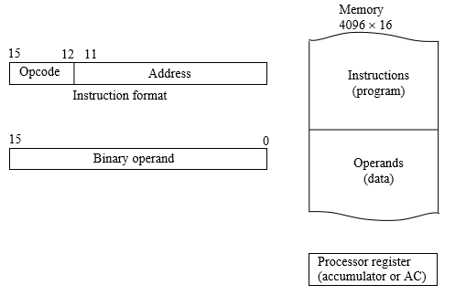
As an example, consider the instruction sequence for the operation C = A + B:
LDA A: Load the content of memory location A into the Accumulator (AC).
ADD B: Add the content of memory location B to the data in the Accumulator (AC).
Store C: Store the result in the Accumulator (AC) back to the memory location designated for C.
In this architecture, we have a Program Counter (PC) responsible for storing addresses, and it is connected to the memory. Additionally, there is an Accumulator (AC) connected to the Arithmetic Logic Unit (ALU).
The data stored in memory is retrieved and transferred to the Instruction Register (IR), from where it is moved to the Accumulator (AC) and subsequently processed in the Arithmetic Logic Unit (ALU).
Single Accumulator Organization

Slide 6
Advantages:
Simple instruction set.
Smaller CPU size.
Disadvantages:
High memory traffic as all intermediate results pass through the accumulator.
Slower execution due to frequent memory access.

Slide 7
General Register Organization:
In this organization, the instruction format needs 2 or 3 register address fields according to the operation.
Generally CPU has seven general registers. Register organization show how registers are selected and how data flow between register and ALU.
A decoder is used to select a 3 particular register. The output of each register is connected to two multiplexers to form the two buses A and B.
The selection lines in each multiplexer select the input data for the particular bus. The A and B buses form the two inputs of an ALU.
The operation select lines decide the micro-operation to be performed by ALU.
The result of the micro-operation is available at the output bus. The output bus connected to the inputs of all registers, thus by selecting a destination register it is possible to store the result in it.

Slide 8
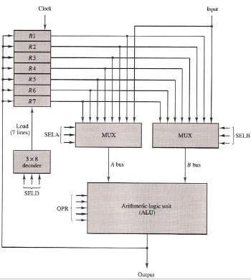
Register Based Organization

Slide 9
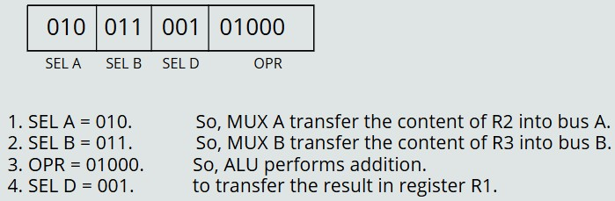
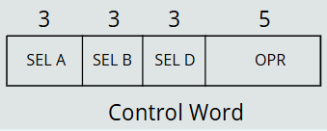
Example, Let we want to perform the operation R1 ← R2 + R3
To do this operation, Control Unit generates following signal (Control Word).
Control Word
A control word, designed for the aforementioned CPU organization, consists of four fields as illustrated below:

Slide 10
The three bits of SEL A are dedicated to transferring the contents of a register into BUS A.
The three bits of SEL B are assigned to transferring the contents of a register into BUS B.
The three bits of SELD are utilized for selecting a destination register. This facilitates the decision of whether to store the result in a register or to transmit it outside the ALU.
The five bits of OPR define the type of operation to be performed by the ALU. This field governs the arithmetic or logical operation executed by the ALU based on the specified opcode.
Binary code | SELA | SELB | SELD
000 | Input | Input | None
001 | R1 | R1 | R1
010 | R2 | R2 | R2
011 | R3 | R3 | R3
100 | R4 | R4 | R4
101 | R5 | R5 | R5
110 | R6 | R6 | R6
111 | R7 | R7 | R7
Register and multiplexer input selection code

Slide 11
Operation Selection Code | Operation | Symbol
00000 | Transfer A | TSF
00001 | Increment A | INC
00010 | A+B | ADD
00101 | A-B | SUB
00110 | Decrement A | DEC
01000 | A AND B | AND
01010 | A OR B | OR
01100 | A XOR B | XOR
01110 | Complement A | COM
10000 | Shift Right A | SHR
11000 | Shift Left A | SHL
Operation with symbol

Slide 12
Advantages:
Efficiency of CPU increases as there are a large number of registers used in this organization.
Less memory space is used to store the program since the instructions are written in a compact way.
Faster execution as data is readily available in registers.
Flexible programming due to multiple registers.
Disadvantages:
Care should be taken to avoid unnecessary usage of registers. Thus, compilers need to be more intelligent in this aspect.
Since large numbers of registers are used, thus extra cost is required in this organization.
Increased hardware complexity due to more registers.

Slide 13
Stack Organization
The memory of a CPU can be organized as a STACK, a structure where information is stored in a Last-In-First-Out (LIFO) manner. This means that the item last stored is the first to be removed or popped.
To manage the items, a stack uses a stack pointer (SP) register. The stack pointer stores the address of the last item in the stack, essentially pointing to the topmost element.
Stack operations involve two main actions:
Insertion (Push): When an item is added to the stack, it is referred to as insertion or a push operation.
Deletion (Pop): When an item is removed from the stack, it is known as deletion or a pop operation.

Slide 14
There are two main types of stacks:
Register Stack: Utilizes processor registers to create a stack structure, enhancing speed and efficiency in certain operations.
Memory Stack: Involves using dedicated memory locations to implement the stack structure.

Slide 15
Register Stack
When processor registers are organized in a stack-like fashion, it is termed a register stack. The diagram below illustrates a 64-word register stack.
The stack pointer (SP) contains the address of the topmost element in the stack.
When the stack is empty, the EMPTY flag is set to 1, and when the stack is full, the FULL flag is set to 1.
The DR (Data Register) contains the data either being popped from or pushed into the stack.
Additional benefits of a register stack include faster access times and reduced memory bus contention, making it suitable for certain computing tasks requiring high-speed data manipulation.
For example, in the figure, three items (A, B, and C) are placed in the stack, with item C at the top. Thus, the stack pointer (SP) holds the address of C (SP = 3).

Slide 16
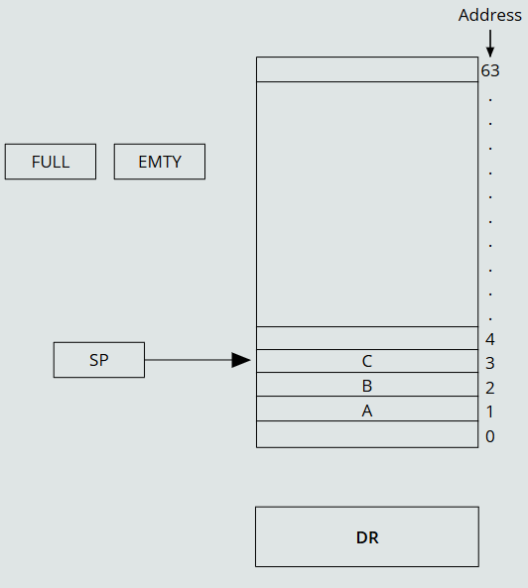
PUSH Operation: When performing a PUSH operation to add an element (let's say E) to the stack, the following steps are executed:
o Step 1: Increment the Stack Pointer (SP) by 1 so that it points to an empty slot. SP ← SP + 1 [Increment stack pointer]
o Step 2: Store the value of the Data Register (DR) at the address pointed to by SP. M[SP] ← DR [Write the item on top of the stack]
o Step 3: Check boundary conditions. If (SP = 0), then set FULL ← 1 indicating the stack is full. EMPTY ← 0 signifies that the stack is not empty.
Block Diagram of a 64-word stack

Slide 17
POP Operation: When performing a POP operation to remove an element from the stack, the following steps are executed:
o Step 1: Retrieve the data from the address stored in the Stack Pointer (SP) and store it in the Data Register (DR). DR ← M[SP] [Fetch item from the top of the stack]
o Step 2: Decrement the Stack Pointer (SP) by 1. SP → SP - 1
o Step 3: Check boundary conditions. if (SP = 0) then (EMPTY ← 1) [Check if the stack is empty] FULL ← 0 [Mark the stack as not full]
Block Diagram of a 64-word stack

Slide 18
Memory Stack
When primary memory (RAM) is organized in the form of a stack, it is referred to as a Memory Stack.
The Program Counter (PC) indicates the address of the next instruction in the program.
The Address Register (AR) points to an array of data within the memory stack.
The Stack Pointer (SP) identifies the top of the stack.
In the illustrated figure below, the initial value of SP is 4001, and the stack grows with decreasing addresses. Consequently, the first item stored in the stack is at address 4000, the second item at address 3999, and the last item at address 3000.

Slide 19
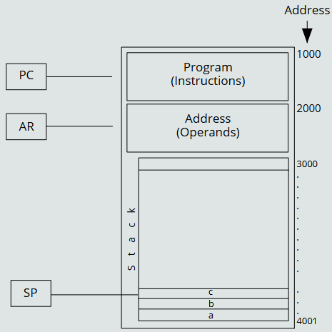
PUSH Operation: The PUSH operation involves decrementing the Stack Pointer (SP) to allocate space for a new item and storing the value from the Data Register (DR) at the address pointed to by the updated SP.
SP → SP - 1
M[SP] ← DR
POP Operation: The POP operation retrieves the item from the top of the stack by copying the data from the address indicated by SP to DR. Subsequently, SP is incremented to free up space in the stack.
DR ← M[SP]
SP → SP + 1
Memory Stack

Slide 20
Advantages:
Compact instructions save memory.
Simplified hardware design.
Disadvantages:
Limited access to stack elements.
Overhead for managing the stack.

Slide 21
References
Reference Books:
J.P. Hayes, “Computer Architecture and Organization”, Third Edition.
Mano, M., “Computer System Architecture”, Third Edition, Prentice Hall.
Stallings, W., “Computer Organization and Architecture”, Eighth Edition, Pearson Education.
Text Books:
Carpinelli J.D,” Computer systems organization &Architecture”, Fourth Edition, Addison Wesley.
Patterson and Hennessy, “Computer Architecture” , Fifth Edition Morgaon Kauffman.

Slide 22
Other References
https://www.slideshare.net/sangitavishwakarma1/cpu-organisation
https://dodiyahiten.files.wordpress.com/2012/09/chapter-7-central-processing-unit.pdf
Video References
https://www.youtube.com/watch?v=llBYrJd6yUw

